Slide 1



Library Management
x
Group member: Zhang Wanjuan
Yang Siyu
Jiang Yuhan

Slide 2






Library Managment
member
Operation interface

Slide 3
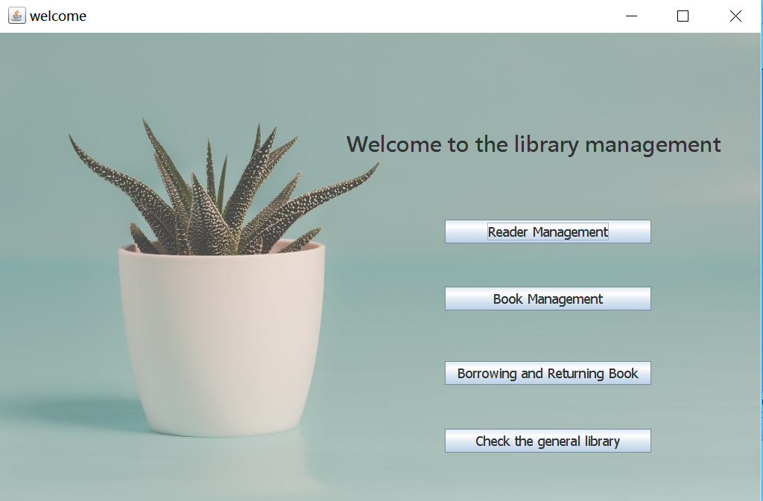
功能
1
化
The welcome screen
Reader management
Book Management
Borrowing and Returning Book

Slide 4
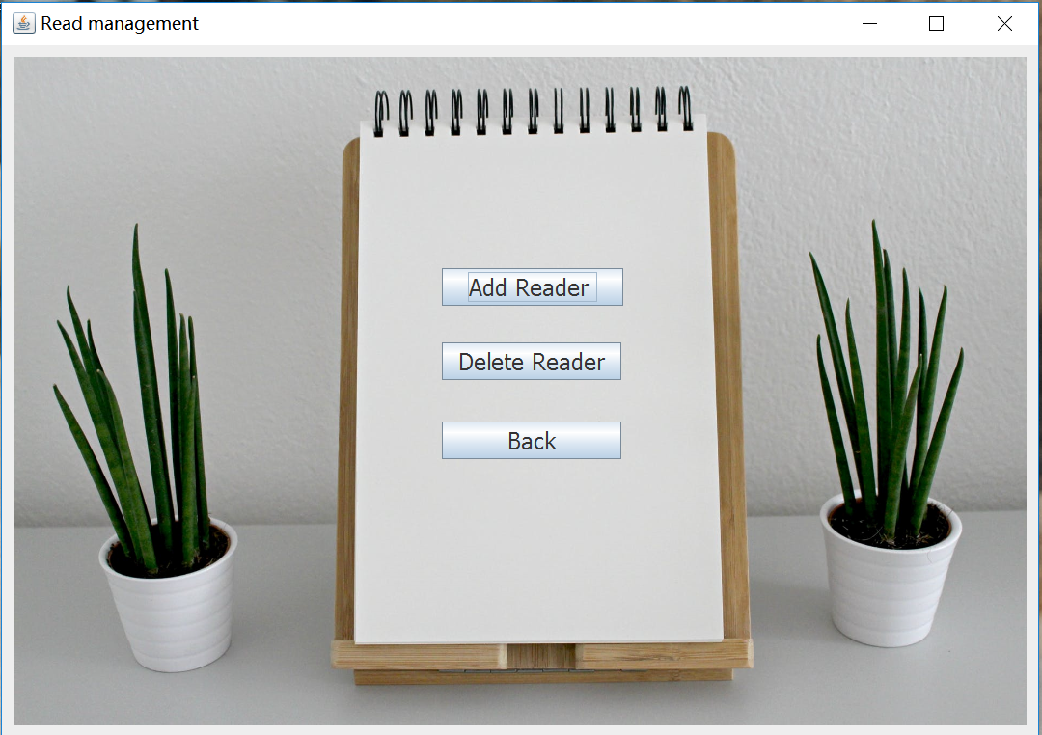
功能
2
化
The welcome screen
Reader management
Book Management
Borrowing and Returning Book

Slide 5
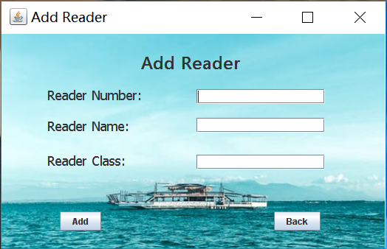
功能
3
化
The welcome screen
Reader management
Book Management
Borrowing and Returning Book

Slide 6
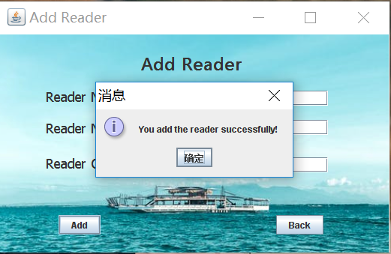
功能
4
化
The welcome screen
Reader management
Book Management
Borrowing and Returning Book

Slide 7
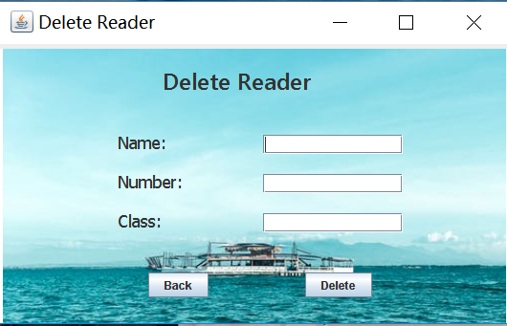
功能
5
化
The welcome screen
Reader management
Book Management
Borrowing and Returning Book

Slide 8
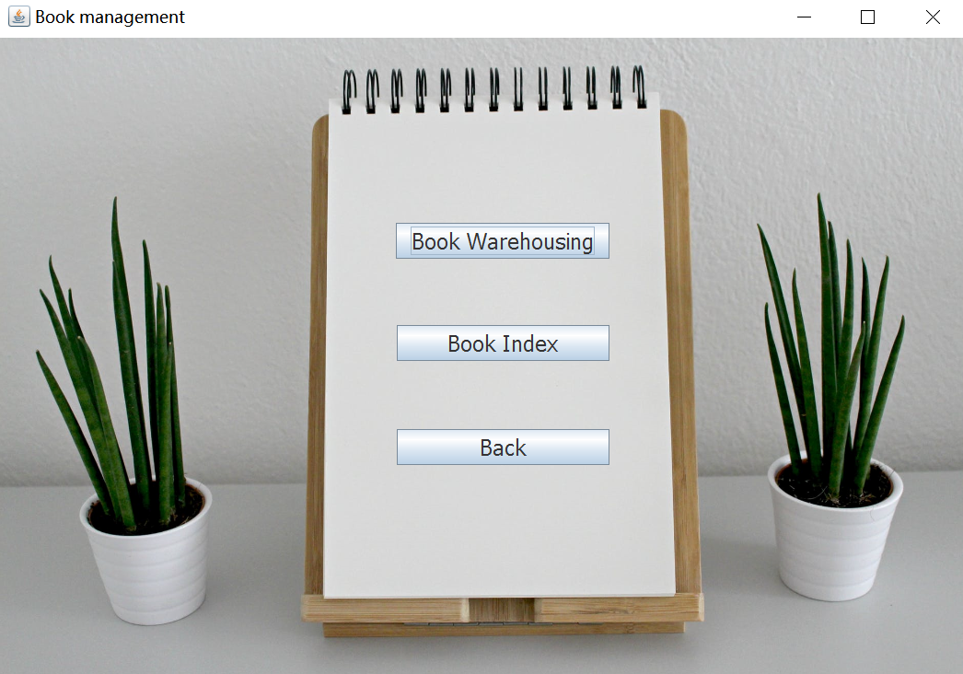
功能
6
化
The welcome screen
Reader management
Book Management
Borrowing and Returning Book

Slide 9
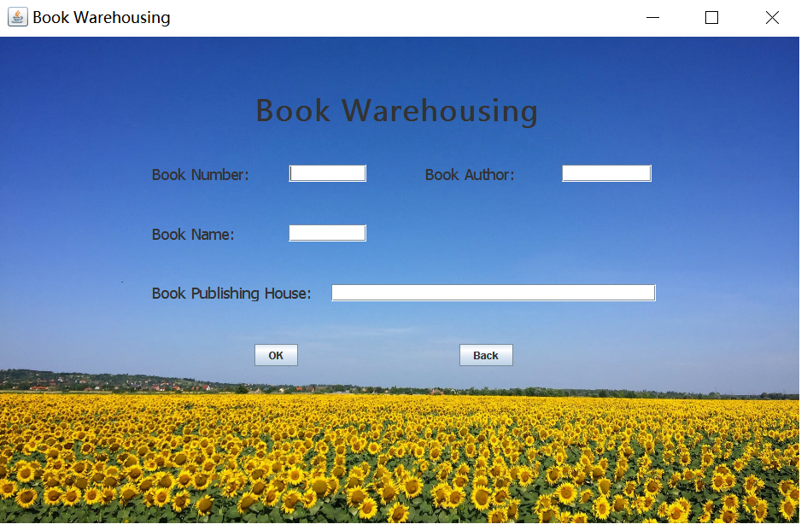
功能
7
化
The welcome screen
Reader management
Book Management
Borrowing and Returning Book

Slide 10
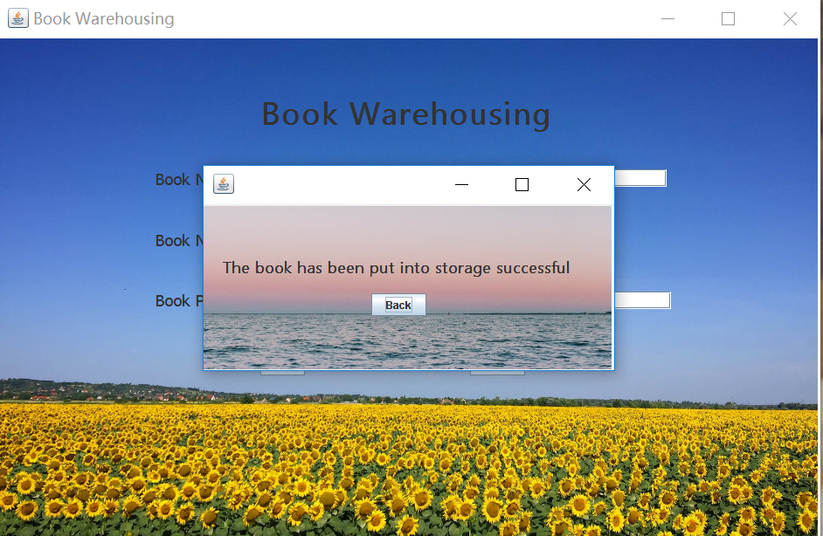
功能
8
化
The welcome screen
Reader management
Book Management
Borrowing and Returning Book

Slide 11
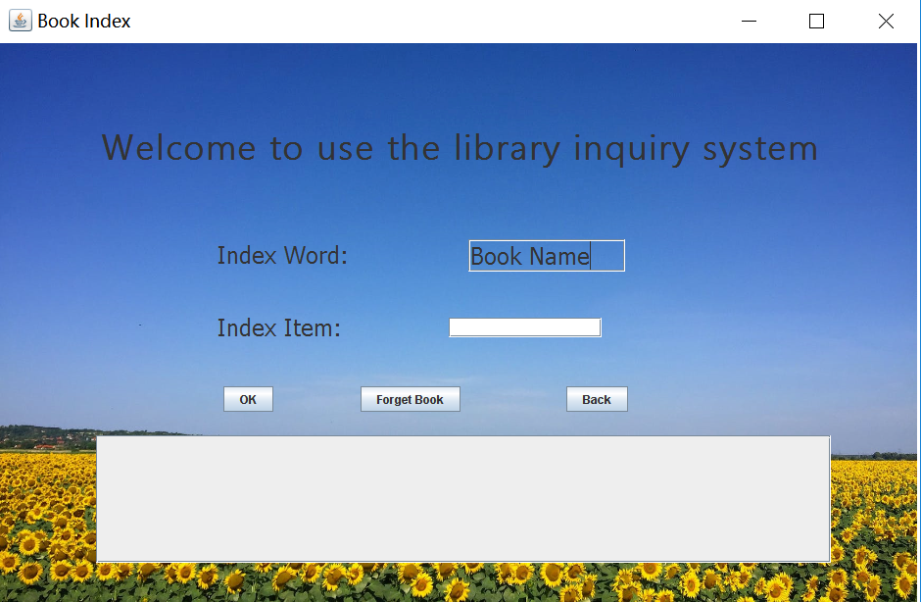
功能
9
化
The welcome screen
Reader management
Book Management
Borrowing and Returning Book

Slide 12
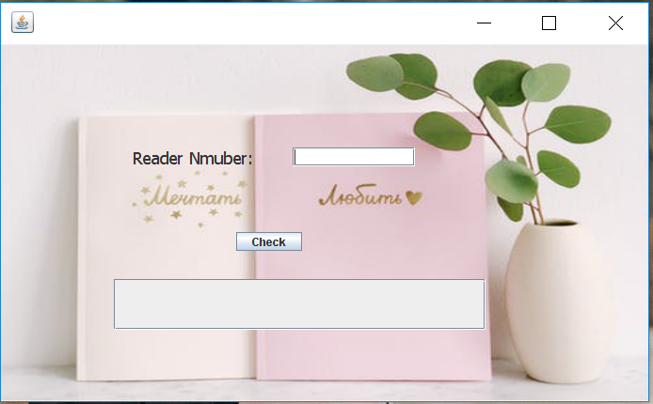
功能
10
化
The welcome screen
Reader management
Book Management
Borrowing and Returning Book

Slide 13
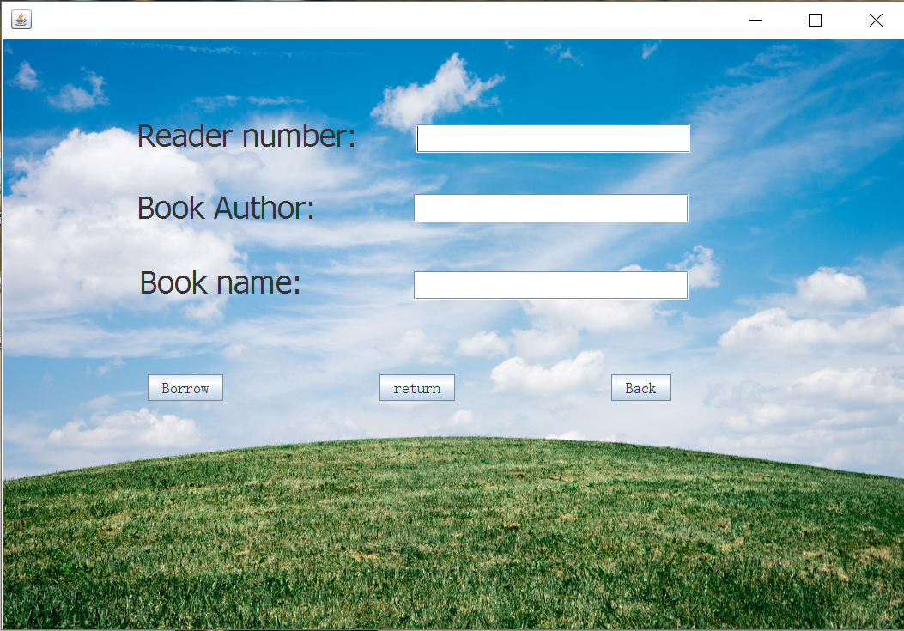
功能
11
化
The welcome screen
Reader management
Book Management
Borrowing and Returning Book

Slide 14
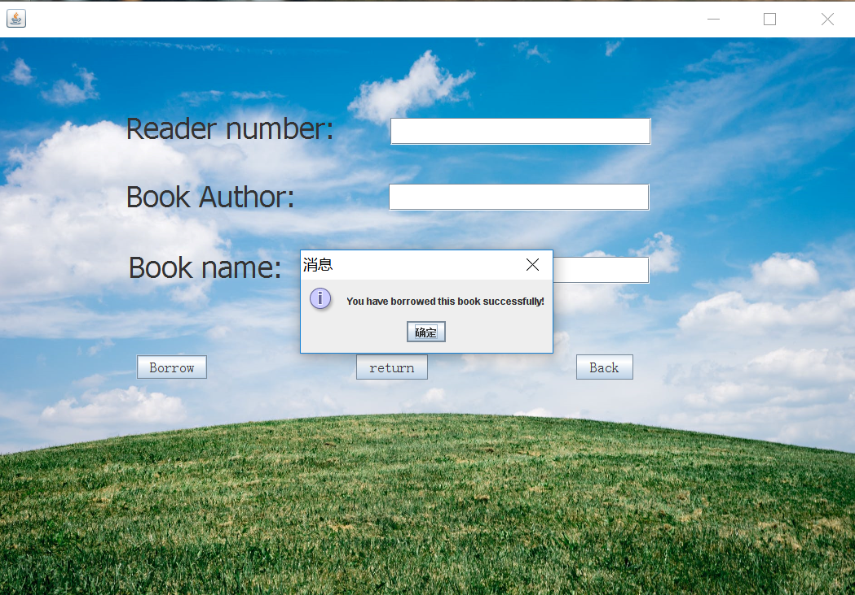
功能
12
化
The welcome screen
Reader management
Book Management
Borrowing and Returning Book

Slide 15

功能
13
化
The welcome screen
Reader management
Book Management
Borrowing and Returning Book

Slide 16
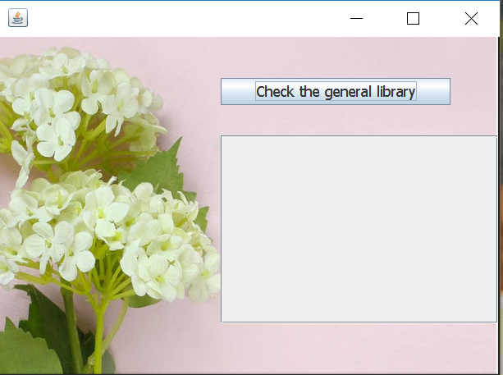
功能
14
化
The welcome screen
Reader management
Book Management
Borrowing and Returning Book

Slide 17
Thank you

